Slide 1
Investment Advisor
Recommend the Best Stocks for Investment

Slide 2
Who we are?
Investment advisers are financial professionals that make investment recommendations or conduct a security analysis
Investment advisers often have discretionary authority over their client’s assets and are required to uphold standards of fiduciary responsibility.
Investment advisers work as professionals within the financial industry by providing guidance to clients in exchange for specific fees. Investment advisers owe a fiduciary duty to their clients and are required to put their client’s interests first at all times.

Slide 3
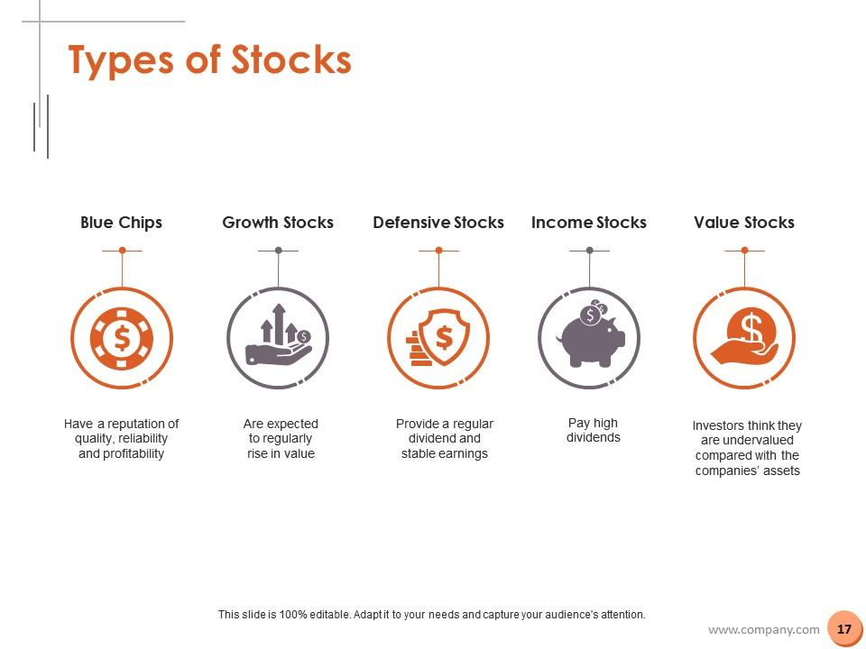

Slide 4
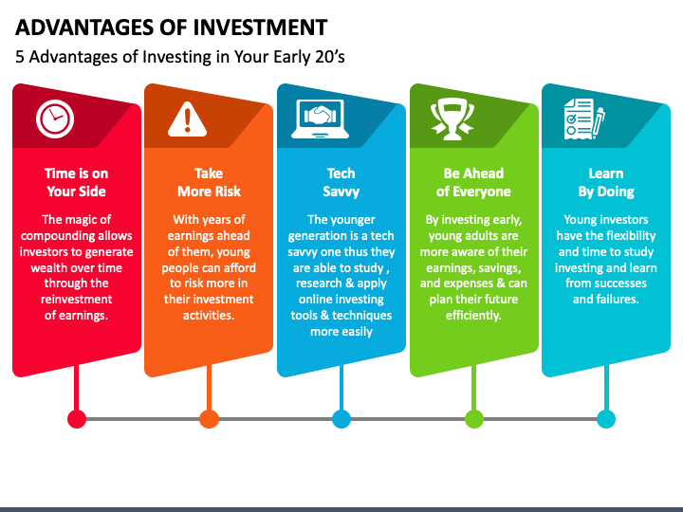

Slide 5
Project Findings-: (subtask-3.1)

Slide 6
From our analysis of the data based on 500 stocks from the BSE index, we found that:
1-Sectors differ significantly from each other in terms of their Enterprise Value (EV), in terms of the median of the EV. The insurance sector has been found to hold the maximum total value of Approx 74000(CR). While the service sector was seen to hold a minimum value of Approx 9000(CR).

Slide 7
Findings (Subtask-3.2)
We began our analysis with the assumption that as Market Capital(MC) increases, Dividend Per Share also increases, thus expecting a positive relation
In order to confirm our assumption the scatter plot was checked, Further, a trend line and regression equation along with R2 was determined. The result reveals that Low level of relationship between the two. Further, a correlation of only 4% confirmed the result from the scatter plot.
Correlation between Dividend Per Share and Market Cap: 0.041

Slide 8
Subtask-3.3
The listed stocks in the data were checked for the 3-year return, clubbing the count of these stocks as per their industry, the values were segregated for negative and positive returns. Based on the result the choice of picking any industry was made on the logic that the probability of getting a higher return will be better in an industry that holds a count of negative return as minimum as possible
 | Count of Company
Industry Names | Negative | Positive
Drugs & Pharma | 5 | 31
Software |  | 24
Banking | 10 | 15
Cement | 1 | 13
Real Estate |  | 12
Organic Chemicals |  | 10
Misc. Fin.services | 5 | 9
Auto Ancillaries | 1 | 9
Electricity Generation |  | 7
Household & Personal Products | 1 | 7
Kitchenware & Appliances |  | 6
Natural Gas Utilities | 1 | 6
Housing Finance | 2 | 5
Construction | 2 | 5
ACs & Refrigerators | 2 | 4

Slide 9
Subtask-3.3
As mentioned in Question which Industry is best for Investment according to analysis no industry gives the same return but the best industry gives the less negative return and gives maximum positive return software, real state, and organic Chemicals are the best industries for investment and software gives all positive returns d the shares of software companies are also in budget and basis on current situation software industries will grow in future

Slide 10
Project Insight (SubTask-3.4)

Slide 11
Further, a deeper analysis was conducted to pick a KPI that could help make decisions related to picking the best stock across different sectors One KPI that was picked to analyze every stock was EV/EBITDA. This KPI was chosen to also consider the company’s operating performance since we picked from a mix of the large-mid-low level of market capital stocks. An interesting fact was that the stocks shortlisted on this criteria also performed well in other KPIs. A peculiar thing noticed about this KPI was that it seemed to give better results for stocks chosen from the low and mid-market capital segments.
The criteria to assort the set of stocks was made based on the following parameters.
Dividend Yield - Between 2-6%
EV/EBITDA - Below 10
Price to Book Value Ratio - Between 1-3
Price to Earning to Growth Ratio - Lower than 1 but not negative
Price to Cash Flow Ratio - Below 15

Slide 12
Unique Insight-1
In the data, it was found that on average the stocks from the low market capital segment increased 100% more than the large market capital segment and 40% more than the mid-market capital segment. However, the picture reverses when we measure the performance of stocks that decreased. In terms of decrease in stock price, on average the stocks from the low market capital segment decreased by 28% more than the large market segment and 23% more than the mid-market capital segment. However, overall, the Low market capital segment has outperformed both mid and large segments.
Unique Insight-2
While for the current day changes in the stock Financial Sector emerged as the top gainer projecting about 62% changes in the stock price. However, according to the last 3 years’ data of high and low, it is revealed that in the Technology sector, the stock prices on average grew by 5.81%. Opposed it, last 5 years of data on stock price variability, the Diversified Sector is seen to be projecting the most growth in the stock price of about 91%

Slide 13


